Slide 1
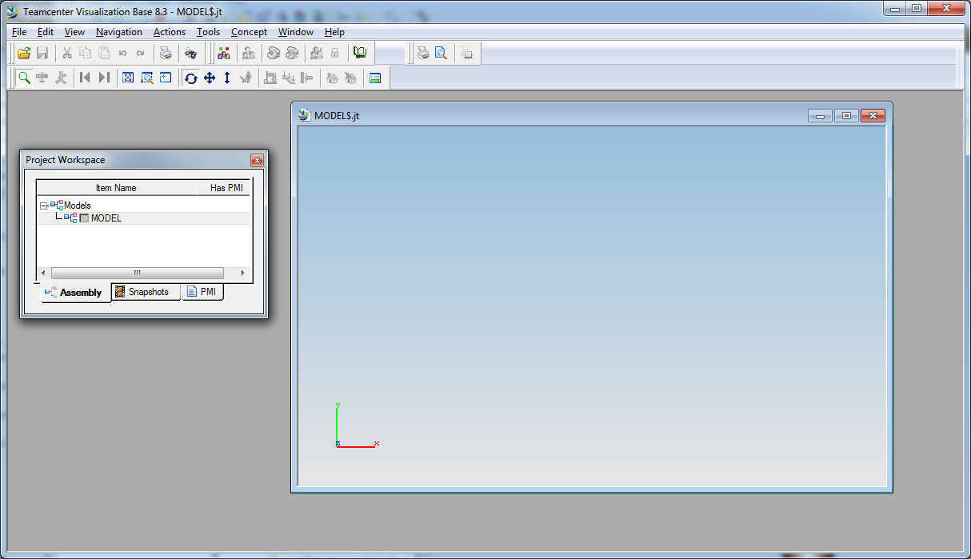

Double click (or “Maximize” ) right hand window

Slide 2
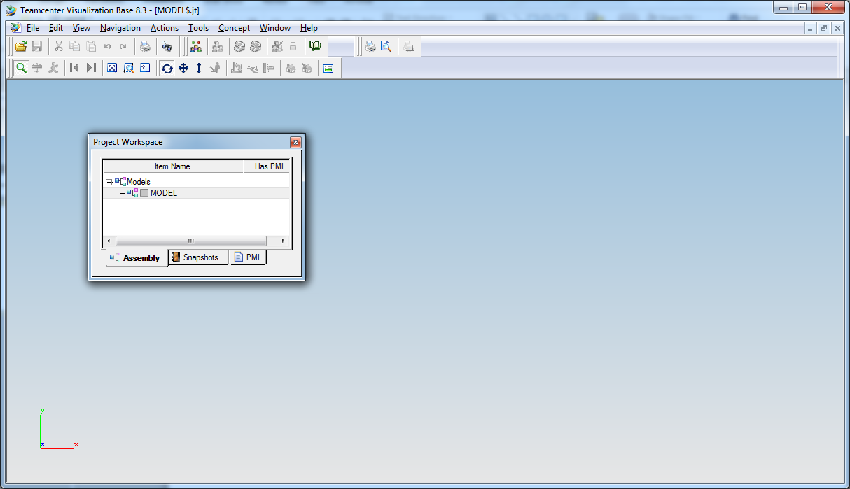
Click and drag the Project Workspace to the left (until it touches), and it will dock vertically
Click and drag the Project Workspace to the right, and it will dock horizontally
(following two slides…)

Slide 3
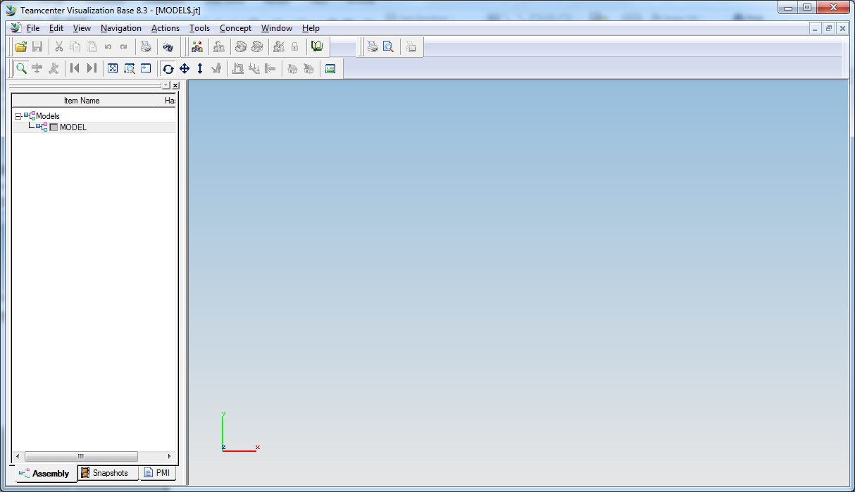

Slide 4
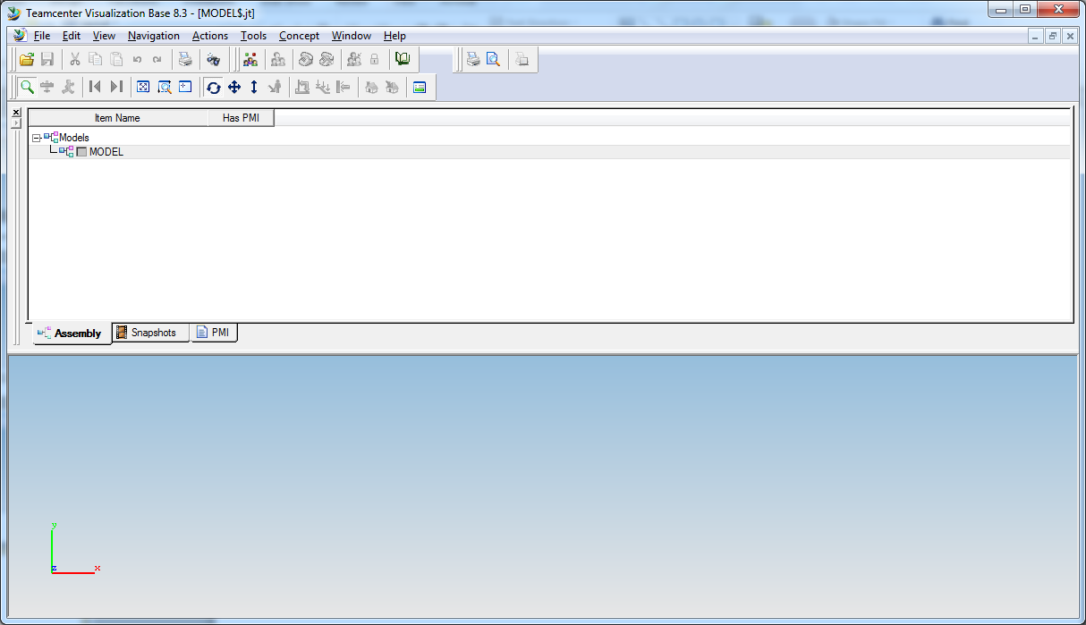

(As yours may have done)
To correct, you may have to undock first (double click the Titlebar ) then, click and drag to left to touch

