Slide 1
TDA/TDE/NCP
Call Queueing

Slide 2
ICD-G 603 Sales, member 102,104,122,125
Group members must use Log-in/out key
DDI 850 for Sales or
OGM 501 ( Day) , „dial 3 for Sales”
OGM 511 „you are the first in the queue”
OGM 512 „you are the second in the queue”
OGM 513…..

Slide 3
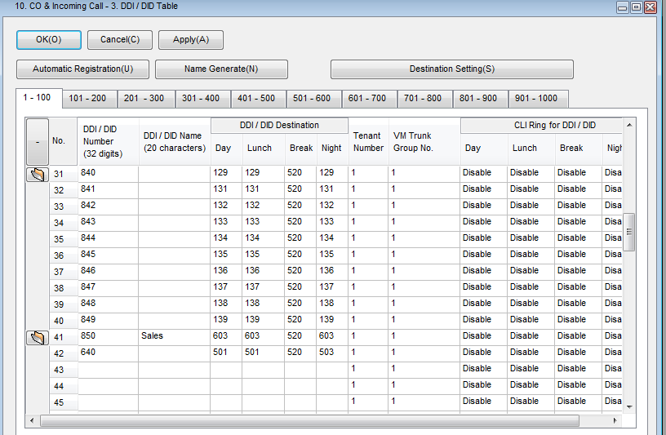

Slide 4
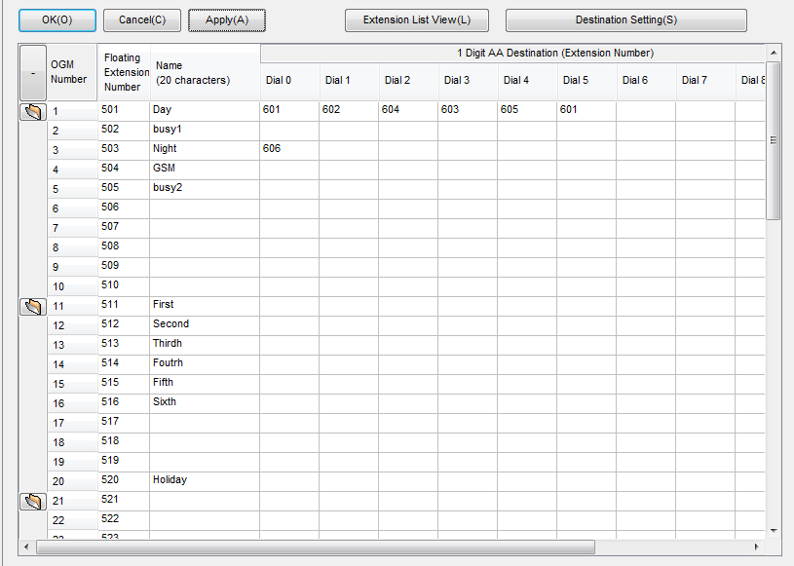

Slide 5
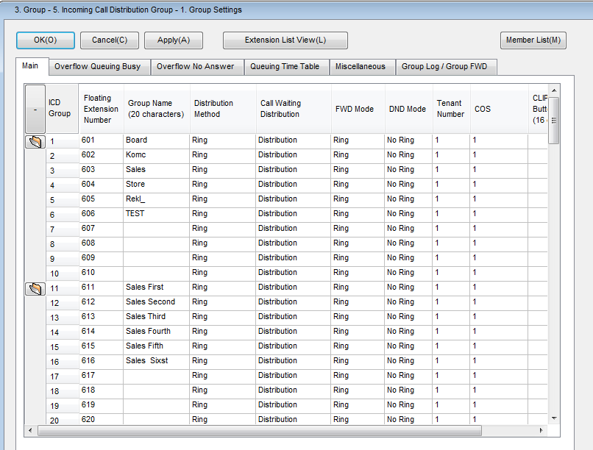

Slide 6
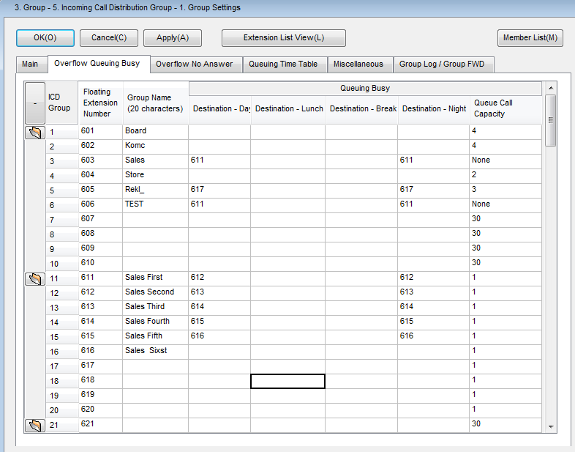

Slide 7
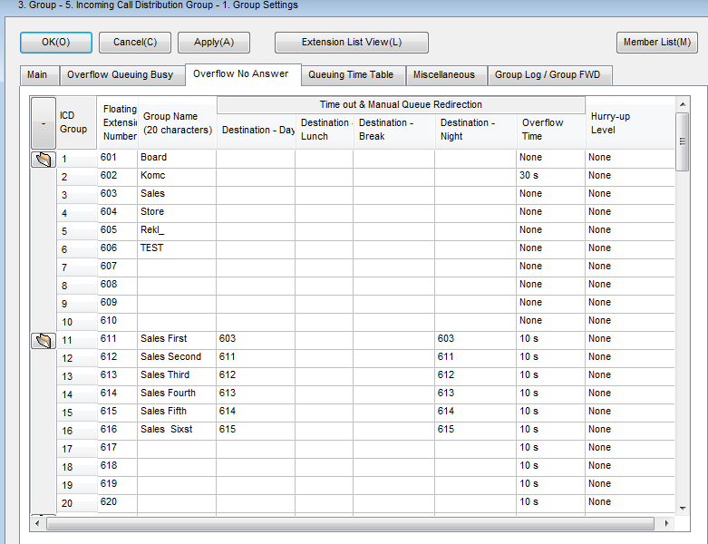

Slide 8
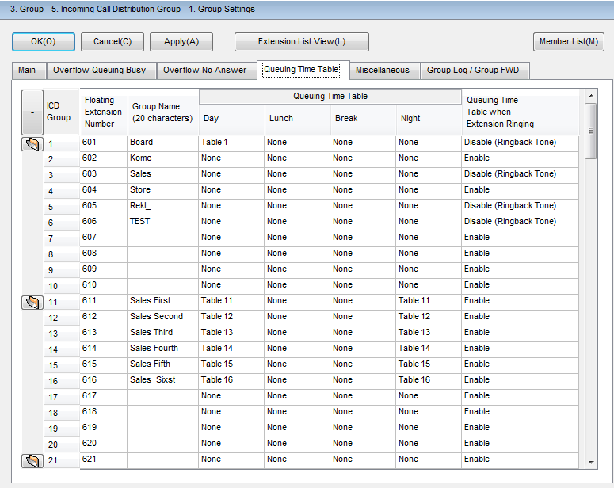

Slide 9
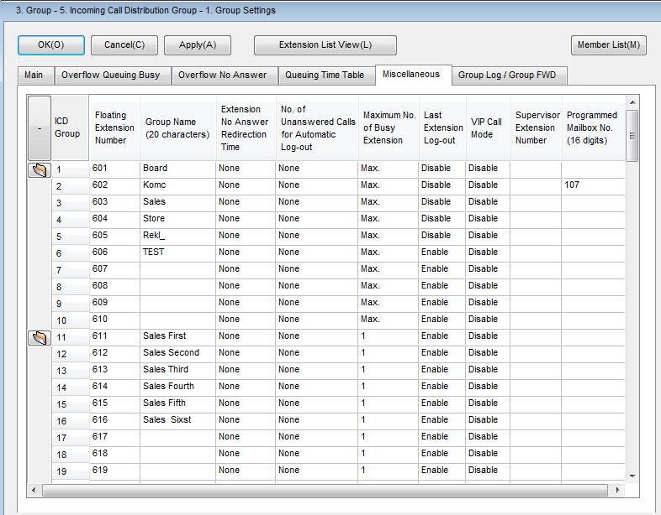

Slide 10
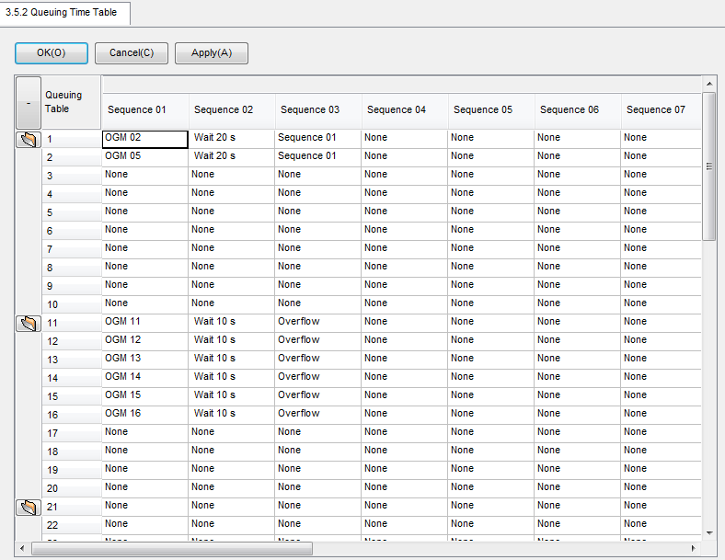

Slide 11
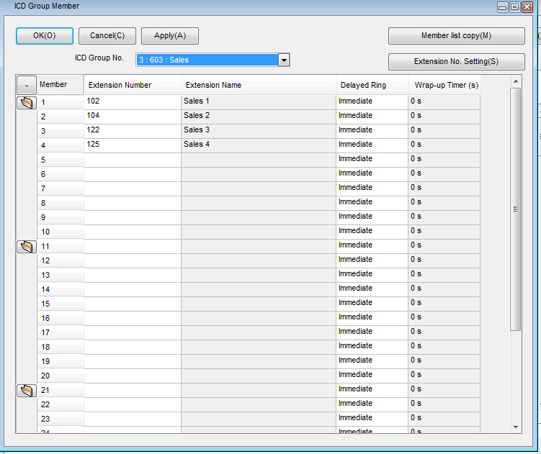

Slide 12
